Slide 1




NEXT GEN EMPLOYABILITY PROGRAM
Creating a future-ready workforce
Team Members
College Name
Student Name :SHALINI SIVAKUMAR
Student ID : 513521104045
ANNAI MIRA COLLEGE OF ENGINEERING AND TECHNOLOGY

Slide 2

CAPSTONE PROJECT SHOWCASE
Project Title
Building Bus Reservation System using Python and Django
Abstract | Problem Statement | Project Overview | Proposed Solution | Technology Used | Modelling & Results | Conclusion

Slide 3
Abstract
Online Bus Ticket Reservation System is a Web based application that works within a centralized network.
This project presents a review on the software program "Online Bus Ticket Reservation System" as should be used in a bus transportation system.
a facility which is used to reserve seats, cancellation of reservation and different types of route enquiries used on securing quick reservations.
OBTRS is built for managing and computerizing the traditional database, ticket booking and tracking bus and travel made.
It maintains all customer details, bus details, reservation details. In order to achieve the design, Imo Transport Company (ITC) was chosen .
Source :

Slide 4
Problem Statement
In this project had many problems for bus bookings in online seats various problems occur
In booking for example location problem,booking cancelled,etc
Customers might use this system to reserve a seat on a bus or book a seat on a plane.
This system would also aid the owner in managing the coaches, staff, clients, services, and
other aspects of the business.
Source :
Cancellation problem

Slide 5
Project Overview
Online Bus Booking System cloud-based online software. This system would help customers to book a seat for their journey, book a bus.
This system would also help the owner to manage the coaches, employees, clients, services, etc.
Bus Reservation System will increase the booking process faster, convenient, and comfortable. Customers can book their desired seats.
They can check the availability of posts on a specific date.
The customer can check availability, book a ticket, or cancel a ticket 24X7.
The online system is available to use anytime. The user doesn’t require to visit any office.
Source :
Bus bookings and cancelation

Slide 6
Proposed Solution
The solution to this problem is to create an online portal for buying bus ticket system.
Customer can buy the bus ticket over the Internet,
24 hours a day,
7daysa week and
the busticket can't be lost,
stolen or left behind.
Source :

Slide 7


Technology Used
Front-end
Back-end
Source :

Slide 8
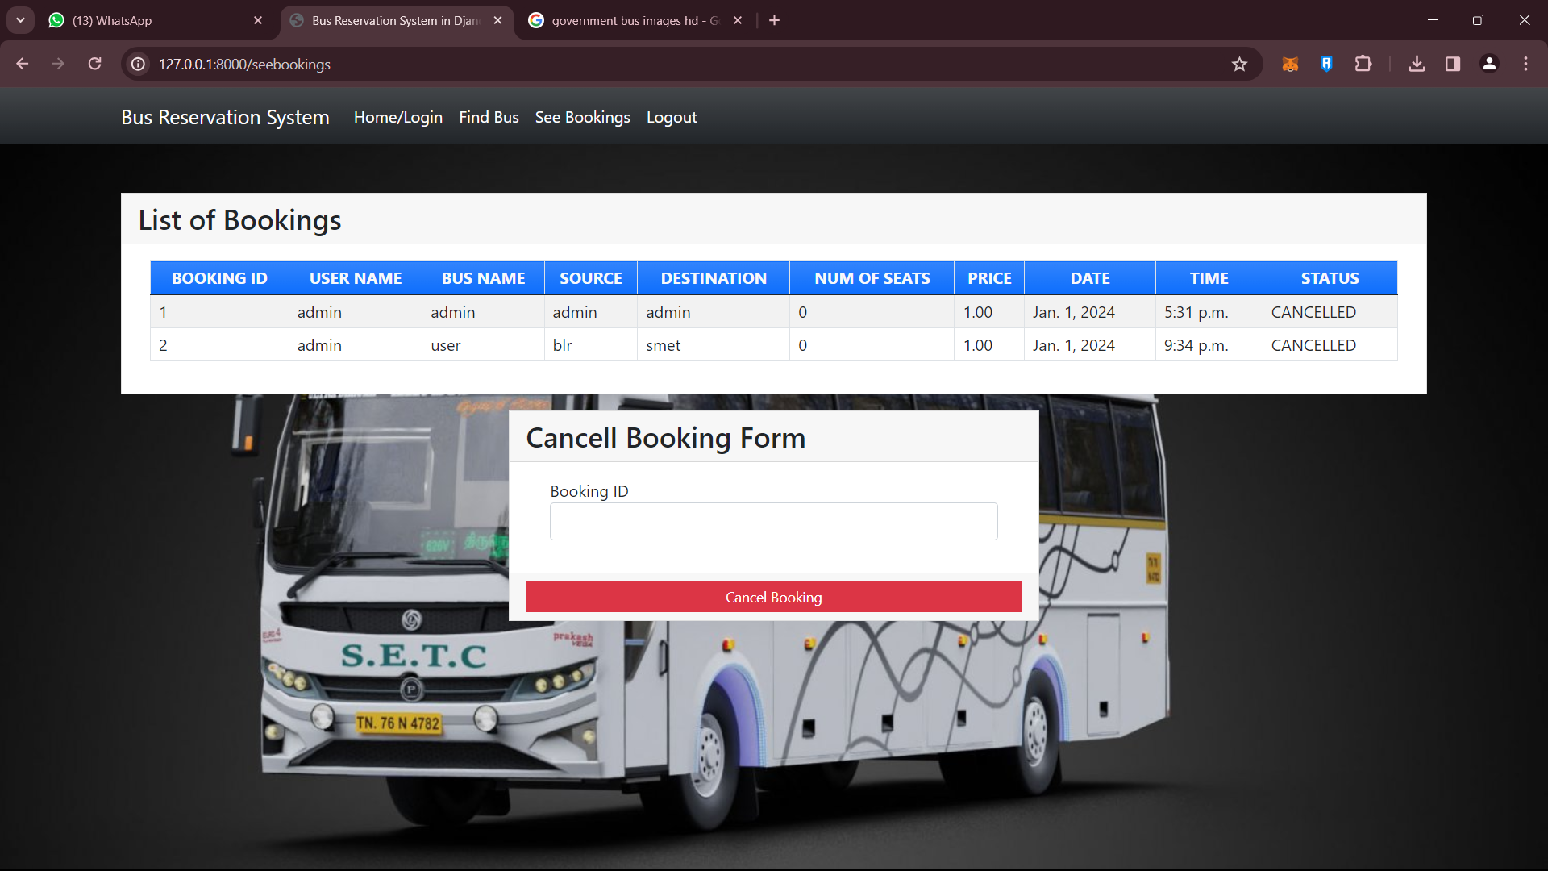
Modelling & Results
A Bus Reservation System ERD is a
comprehensive database diagram illustrating the relationships between entities within a bus reservation system.
This ERD can be used for software design and development, helping developers create structured and efficient software.
It depicts the various entities such as buses, passengers, routes, and ticket reservations.
It also shows the various relationships among these entities, such as how a passenger can book a ticket or how buses are related to a particular route

Slide 9
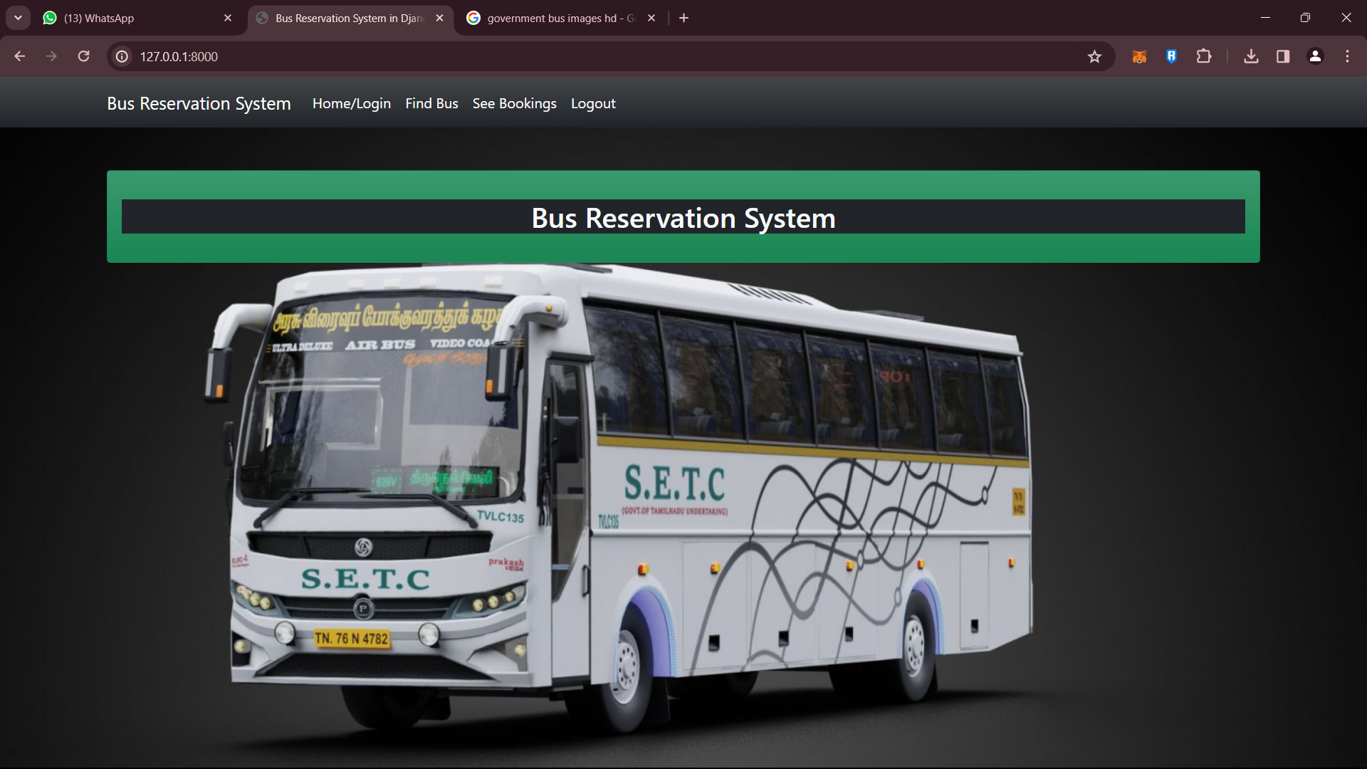
Homepage

Slide 10
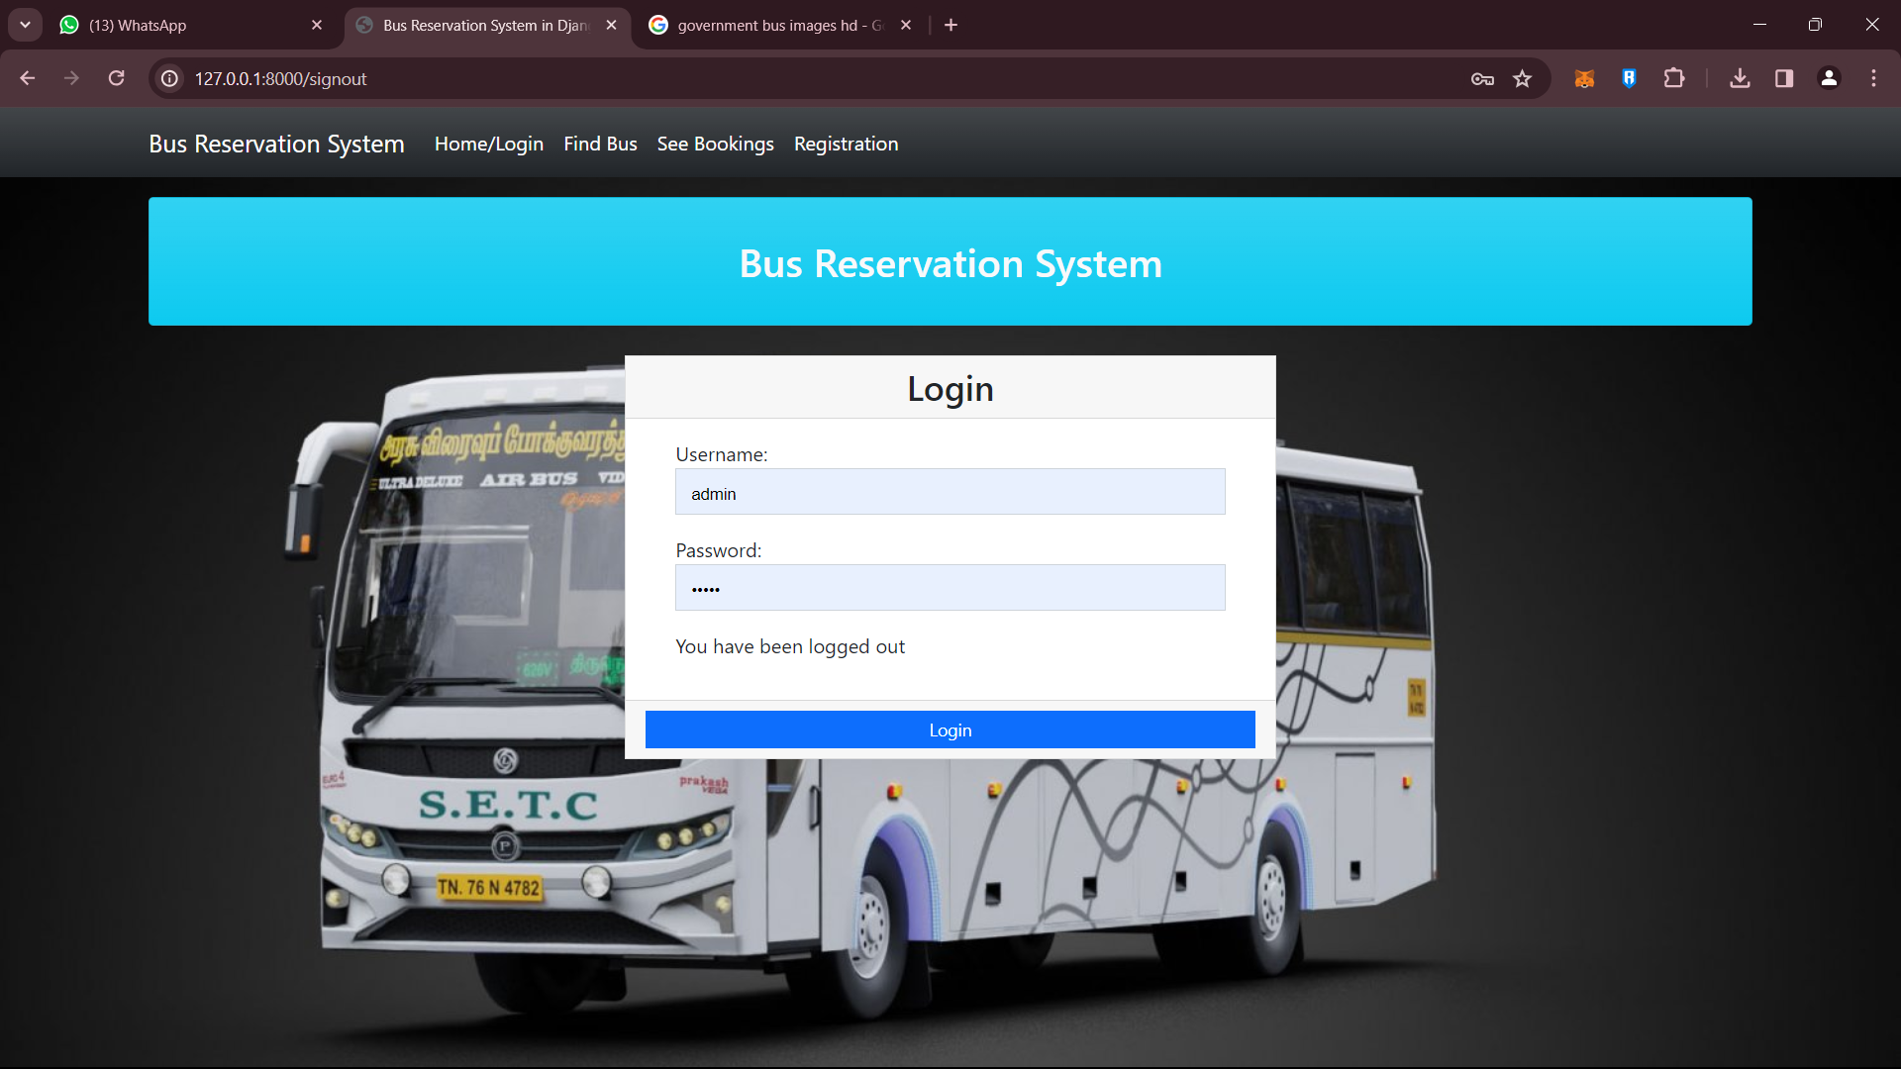
LOGIN

Slide 11
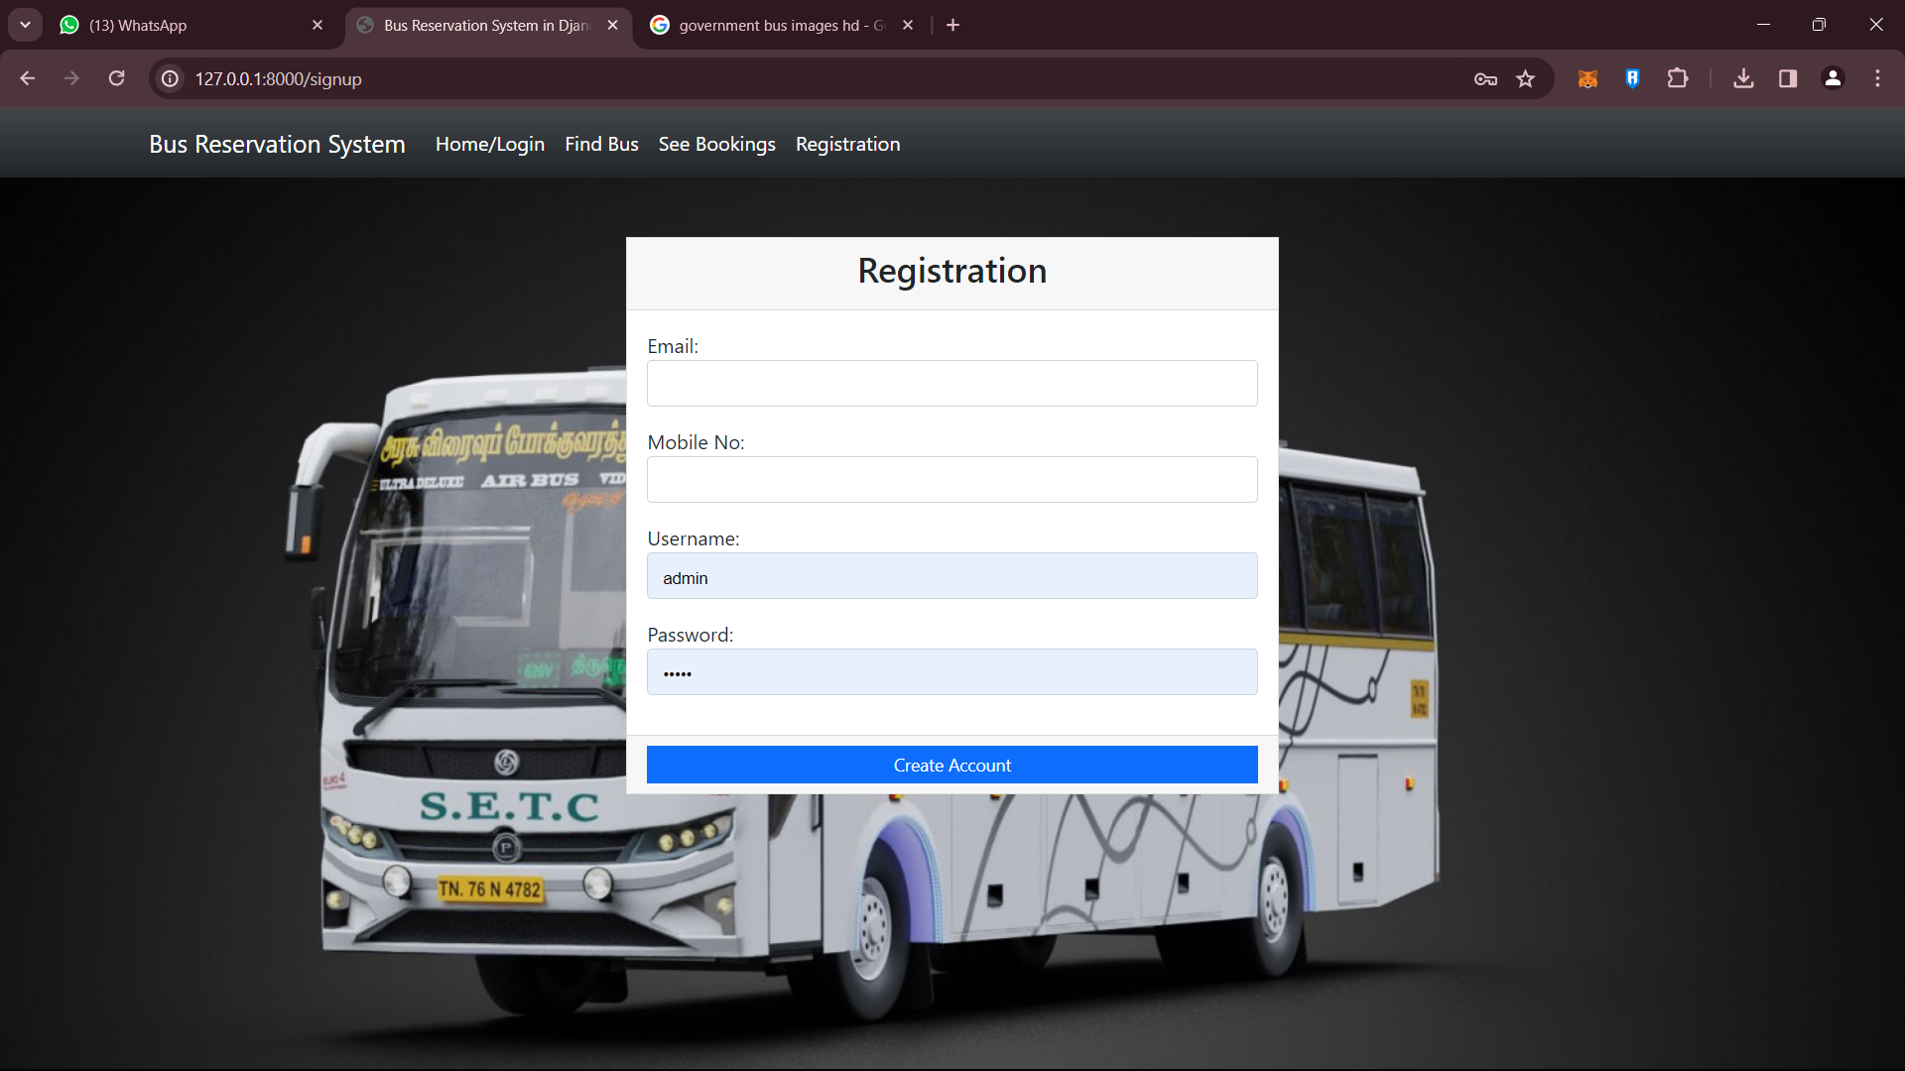
REGISTRATION

Slide 12
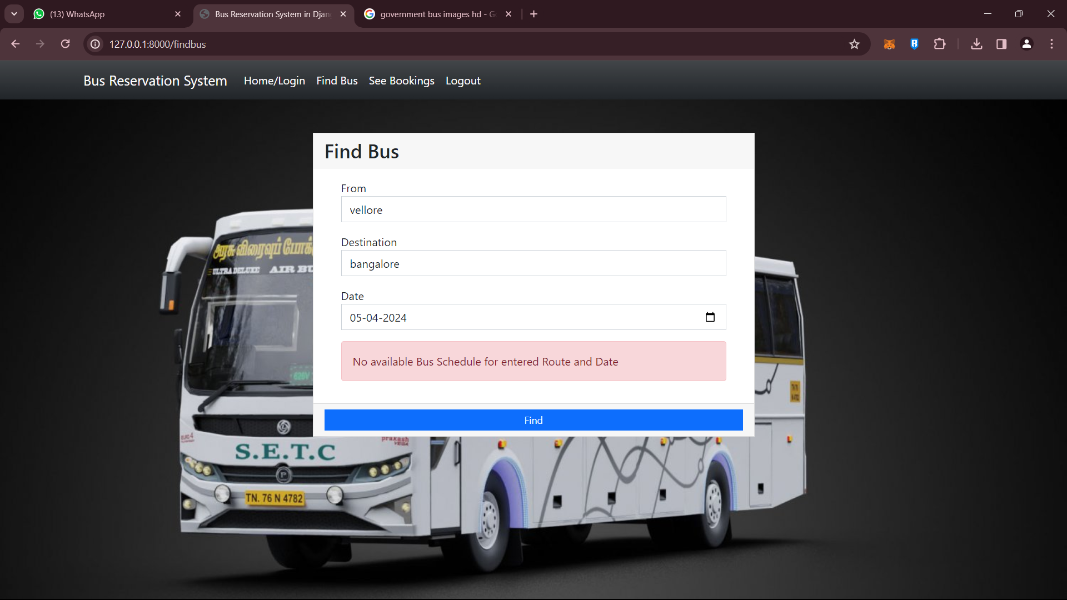
FIND BUS

Slide 13
CONCLUSION
Online ticket booking system is an application where the customer can book a ticket online and 24*7 hours a day from anyplace in the world.
Customers can also interact with the ticket booking website to know any other details they want.
Online ticket booking system has been developed successfully.
System performance is also found to be satisfactory.
This is a user- friendly application.
Through this application, the cost can be reduced and efficiency is increased.
There are several procedures that can be selected by customers. With the help of this

Slide 14
FUTURE ENHANCEMENTS
According to a popular saying, “no man is an island.”
The same can be said for digitally savvy operators and their booking systems.
A bus reservation system must be able to interact with numerous different systems to provide a future-oriented booking experience.
Whether it’s reselling available seats to third parties or integrating with other critical company systems like fleet management, ERP, registers, and social media, we’ve got you covered.
To prevent complexity and difficulties, the current method is to employ a well-structured database schema and service-oriented design.

Slide 15
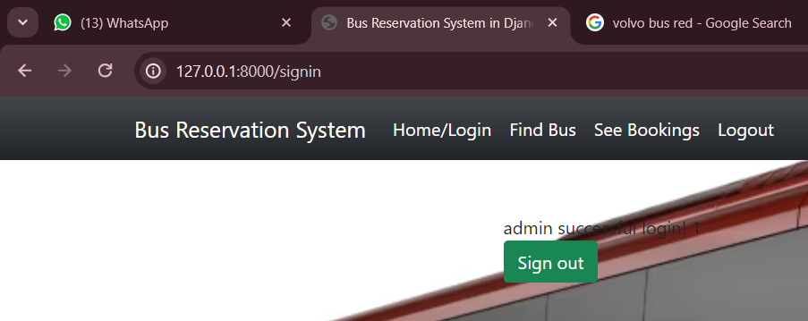
Sign-out

Slide 16
THANK
YOU

